Slide 1
MANAGING PRINT SERVICES
Guided By:
Dr. Snehanshu Saha
Prof. Surbhi Agarwal
Assistant Professor,
CSE Dept.
Team Memebers:
Akhil Bhutani
Komal Rathi
Naveen Kumar R

Slide 2
Problem Statement
In an organization, we have a large number of printers.
For eg., 5 departments each having 10 printers
“ Managing these printers manually “ is a cumbersome job
Creating a software to overcome this problem

Slide 3
Project Description
Centralize the management of printers
Manual Monitoring v/s Software Monitoring
Major Functionalities
Cartridge Level
Number of Pages
Viewing Statistics
Requesting for more quota
Users Involved

Slide 4
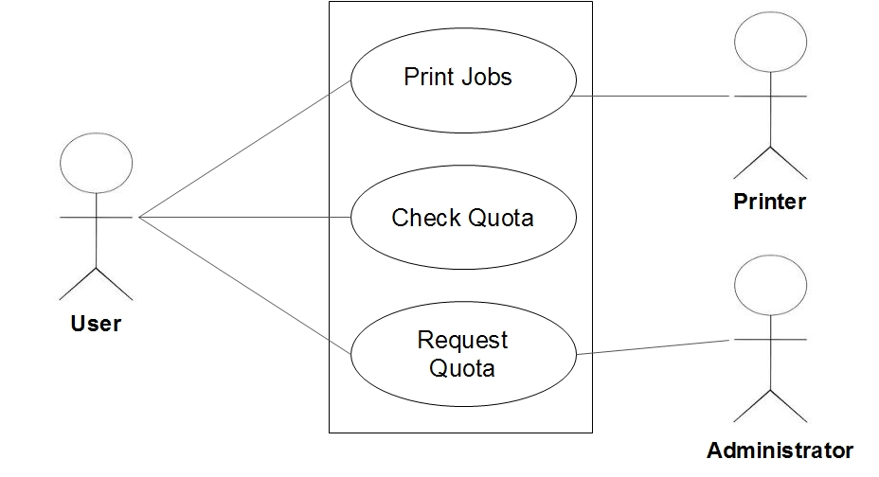
Use Case Diagram ( For End User )

Slide 5
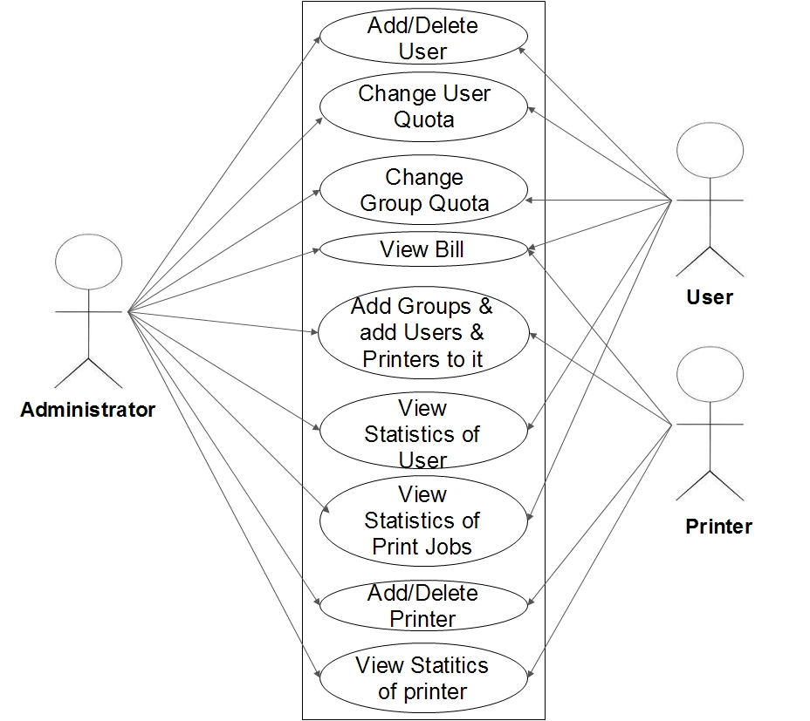
Use Case Diagram ( For Administrator )

Slide 6
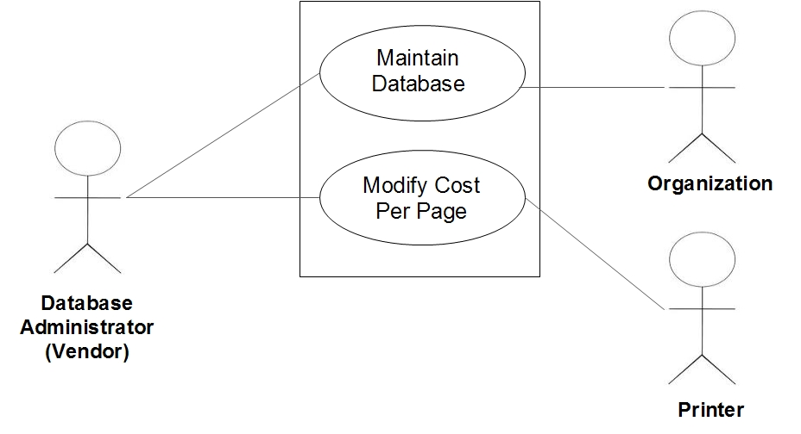
Use Case Diagram ( For Database Manager )

Slide 7
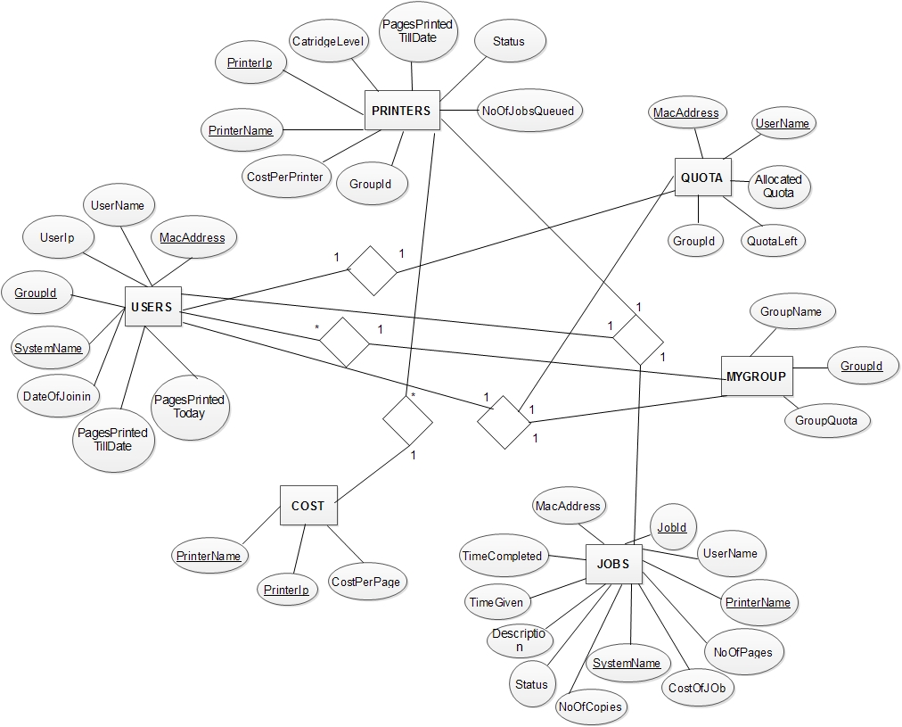
Entity Relationship Diagram

Slide 8
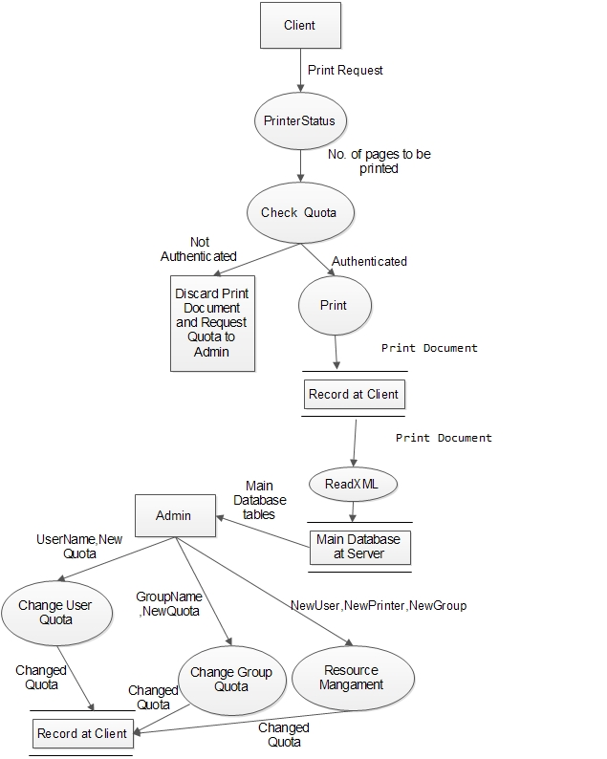
Data Flow Diagram

Slide 9
Service 1 Algorithm
algorithm PrinterStatus
input: Printer list and user lists connected within same network
Step 1: Start
Step 2: Initialize private variables
Step 3: Import all relevant Dll Functions of WinAPI
Step 4: Define the Constructor
Step 5: Create a new thread to call a method ThreadProc within OnStart procedure
Thread t1 <- new Thread(new ThreadStart(ThreadProc))
t1.Start()

Slide 10
Step 6: Define the ThreadProc method
Implement a lock over this method
Update information such as Username MacAddress IPAddress to the database using a flag variable so that it gets updated only once
Define LocalPrintServer myServer <- new LocalPrintServer()
Define PrintQueueCollection
myQueueCollection <- myServer.GetPrintQueues()
for each printer in myQueueCollection do
_mrEvent[i] <- new ManualResetEvent(false)
_waitHandle[i] <- null

Slide 11
for each PrintQueue in myQueueCollection do
if the PrintQueue name is not added to dictionary then
add PrintQueue Name to Dictionary
Make a connection to Printer using OpenPrinter method
if a valid handle is found then
Register the printer for a change notification
Capture the handle
Wait for change notification from the printer queue

Slide 12
Step 7: Define the CallBack function which is called when a change notification occurs
ManualResetEvent _pnwcEvent <- (ManualResetEvent)state
pDictCount <- _handleDict[_pnwcEvent.Handle
PrintQueue myPrintQueue <- new PrintQueue(myServer, CountToPrinterNameDict[pDictCount], PrintSystemDesiredAccess.AdministratePrinter)
myPrintQueue.Pause()
ManagePrinter(myPrintQueue, myServer)
Reset the Event and wait for next Event
Step 8: Define ManagePrinter method
Use Win32_Printer WMI Query to get Port Name of associated Printer
Use SNMP to derive NumberOfPages and Cartridge level from printer

Slide 13
for each job in PrintQueue do
Pause the job
Check for Valid Quota for that user
if Quota Available then
Print the Job
else Remove the Job from PrintQueue
Copy all Job Information to a separate XML file
Step 9: Define the OnStop Procedure
Free all variables from memory
Step 10: End

Slide 14
Service 2 Algorithm
algorithm ReadXML
input: Job information
output: writing all job information to database after specified interval
Step 1: Start
Step 2: Use System.Timers to check the job information at regular intervals
Step 3: Initialize the private variables
Step 4: Define the constructor
Step 5: Define OnStart Procedure
Thread t1 <- new Thread(new ThreadStart(ThreadProc))
t1.Start()

Slide 15
Step 6: Define ThreadProc Procedure
timer.Elapsed +=: new ElapsedEventHandler(OnElapsedTime)
timer.Interval <- 60000;
timer.Enabled <- true;
Step 7: Define EventHandler
if File Exists then
Copy all job information to database
else Create the file and goto step 7
Step 8: Define the OnStop Procedure
time.Enabled <- false
Step 9 :End

Slide 16
Client GUI Algorithm
algorithm ClientUI
input: QuotaRequests
output: Give details about current Quota and allocate the quota requested by user on admin's approval
Step 1: Start
Step 2: Start this application as startup and minimized to tray
Step 3: Place buttons for QuotaLeft and to SendQuotaRequests in design view
Step 4: Define what happens when CheckQuota is clicked
if file exists then
read quota from file and display it to user
else display unable to retrieve quota

Slide 17
Step 5: Define what happens when SendRequests is Clicked
Create a MessageQueue with admin's FormatName
MsgQ <- new MessageQueue
(@"FormatName:DIRECT=TCP:192.168.6.68\Private$\MsgQ")
Send Message to MessageQueue
MsgQ.Send(Environment.MachineName + " has requested " + Quota_Requested + " pages ")
if success then
Show Message Sent to Admin DialogBox
else
Show Cannot requests for Quota... try Again Later...
Step 6: End

Slide 18
Administrator GUI
Algorithm AdminUI
Inputs:Printer Information,User Information,Groups,Jobs,Quota.
Outputs:
1.Provides details of all printers, which are currently connected in LAN, including fax as well.
2.Gives the information about the users in LAN, including system MAC Address as well as IP Address.
3.Create groups for users and Printers.
4.It permits us to easily maitain the Quota allotted to users.
5.It monitors the jobs, which are given by the particular User in the LAN to a particular Printer.

Slide 19
Step1: Start
Step2: Displays the Admin Login for the UserName and Password
Step3: Start Up design gives details of the number of printers connected in the LAN as well in Database, Pages Printed till date, Users in LAN, System UpTime and Printers status.
Step3: Users design, it provides all the neccessary information about the users.
Step4: Printers design, it gives the information about the printers.
Step5: Jobs design, it involves providing all usefull information about users job as well as printers job.
Step6: Billing design, its a financial page, it invloves computing the amount for pages printed by the particular user as well as printer.

Slide 20
Step7: Settings design, it consists of many sub designs such as Users,Printers,Groups and Quota.
Step7.1:Users design, in which it allow the Admin to add the users into the database,once after the system successfully retrived the user in LAN.
Step7.2:Printers design, in which it allow the Admin to add the printers into the database after the system successfully retrived the printers in LAN.
Step7.3:Groups design, which it permit the Admin to add the user to the particular group and upadting the user quota at one shot as well as updating existing user group.
Step7.4:Quota design, the area in which it consists of all user quota requests and printer quota requests and Admin responds to those requests.
Step8:End.

Slide 21
Implementation Specifics
Using Microsoft Visual Studio 10.0 as the IDE
C# and MySQL
XML
SNMP
Private Message Queues

Slide 22
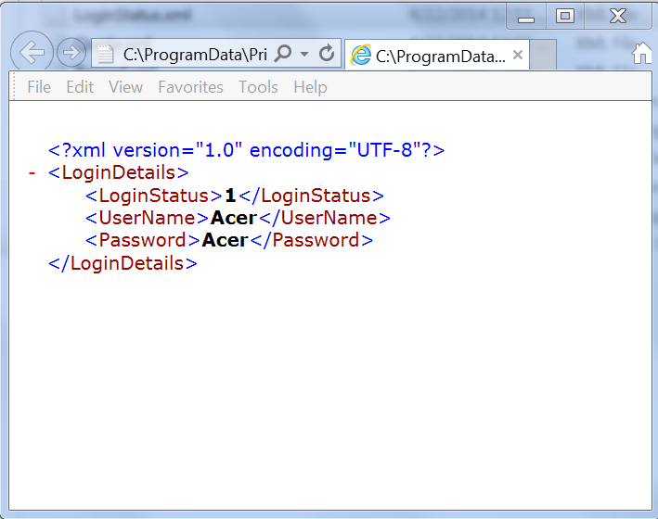
LoginDetails.xml

Slide 23
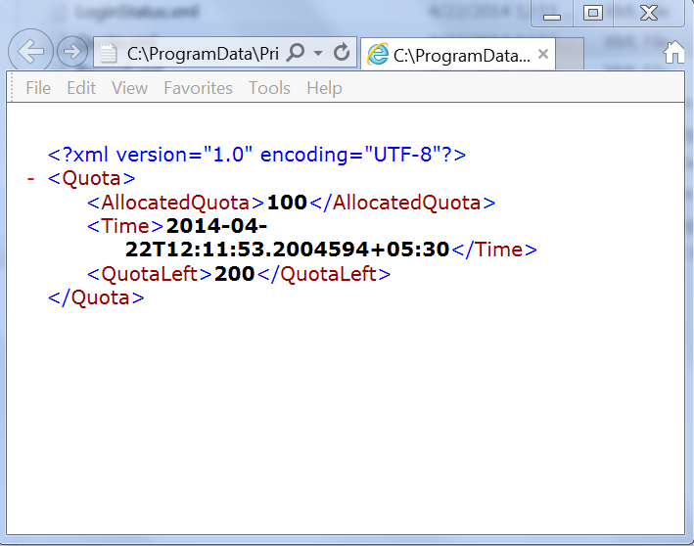
Quota.xml

Slide 24
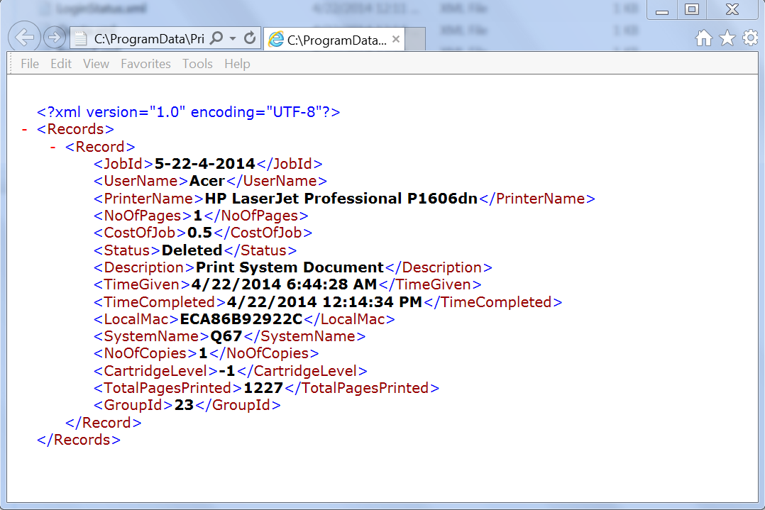
Record.xml

Slide 25
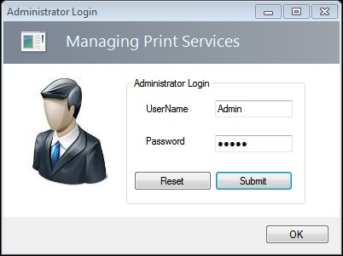
Snapshots
Administrator Login

Slide 26
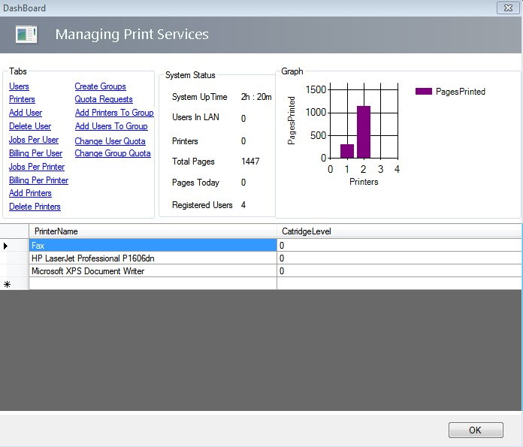
Dashboard

Slide 27
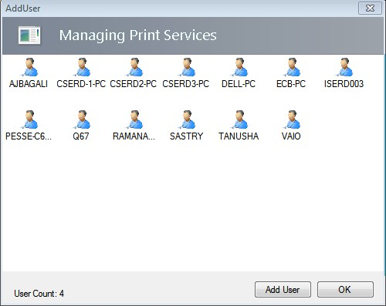
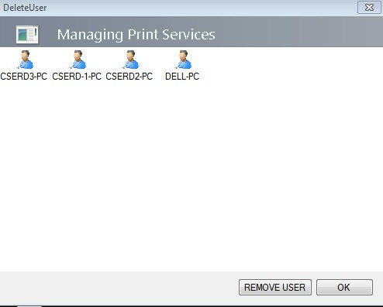
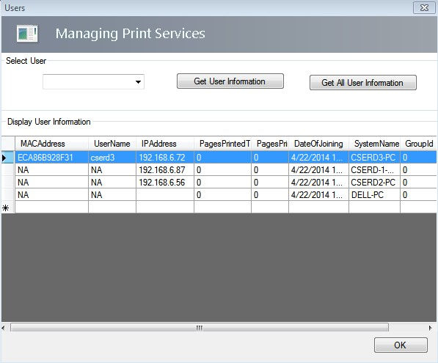
Add New User
Delete Existing User
View User Statistics

Slide 28
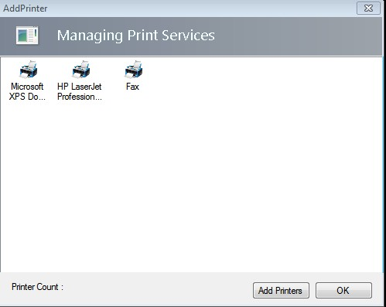
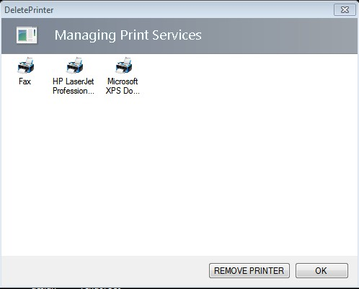
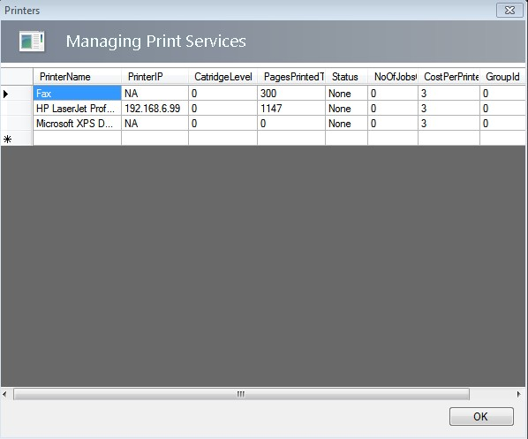
Add New Printer
Delete Existing Printer
View Printer Statistics

Slide 29
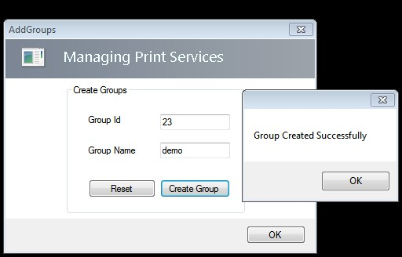
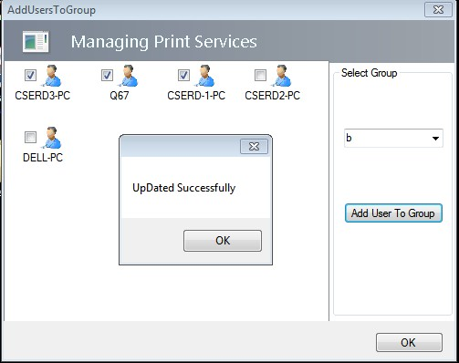
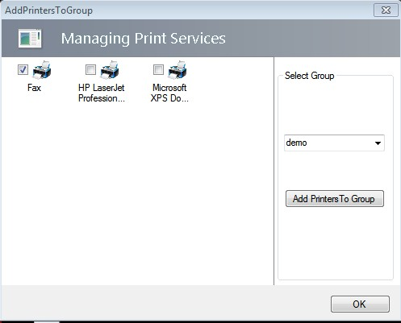
Add New Group
Add New User to Group
Add New Printer to Group

Slide 30
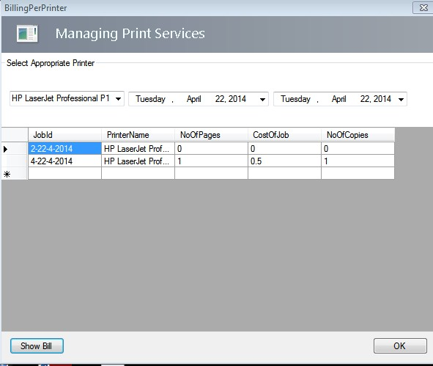
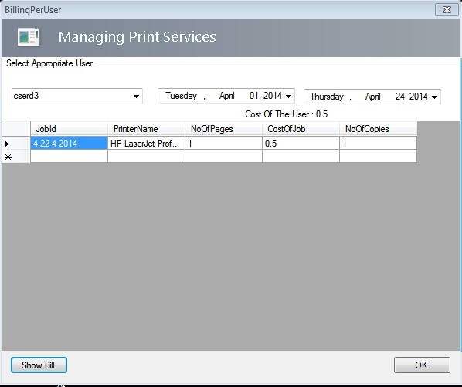
View Bill for a Printer
View Bill for a User

Slide 31
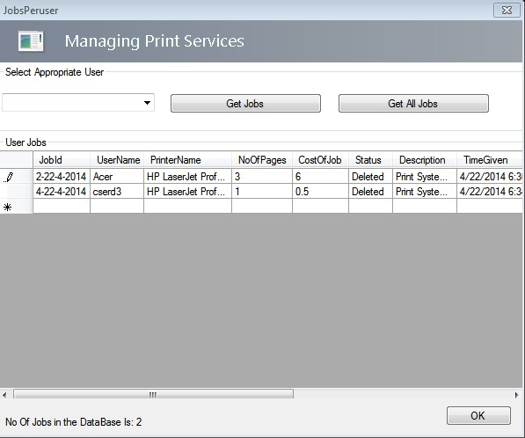
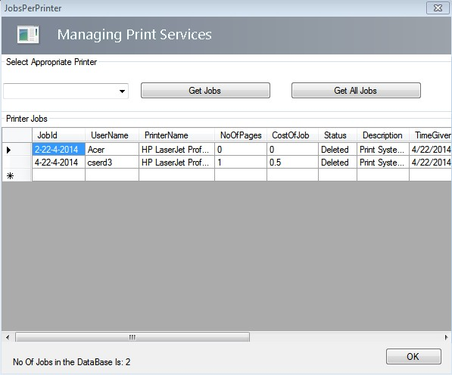
View Jobs of All/One User
View Jobs of All/One Printer

Slide 32
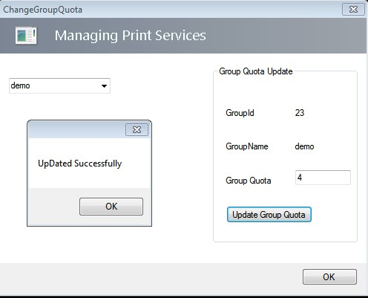
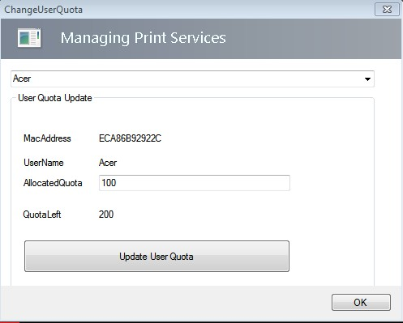
Change Quota of a Group
Change Quota of a User

Slide 33
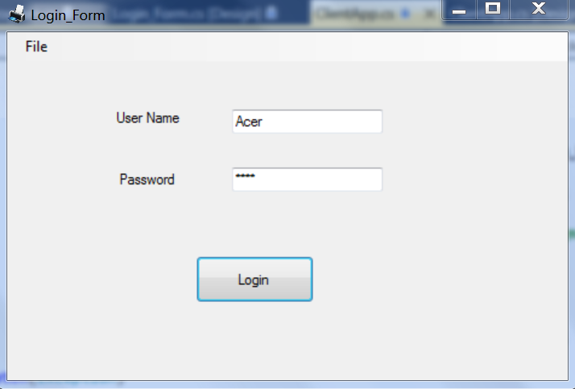
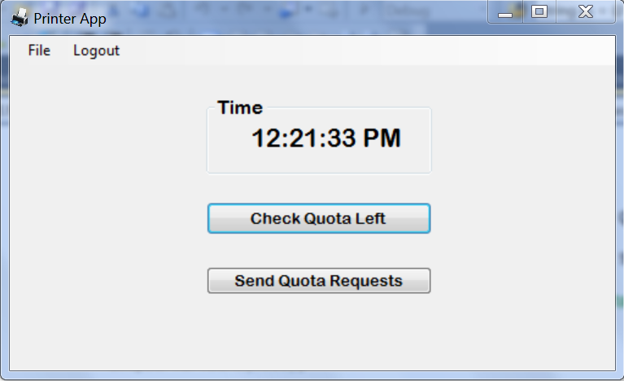
Client UI

Slide 34
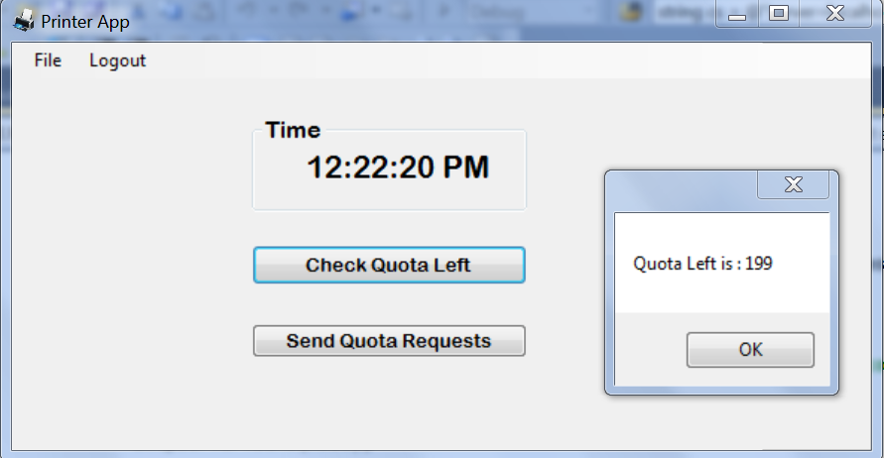
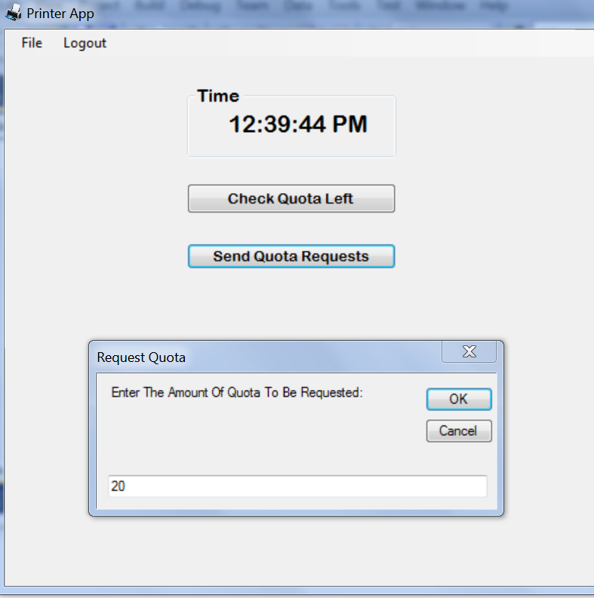
Check Quota Left
Send Quota Requests

Slide 35
Relevance
Misuse of printers can be controlled
Various types of users
Distributed resource management
Time Consuming ??
Easy to use
Cartridge is efficiently utilized

Slide 36
Thank You !

